Slide 1
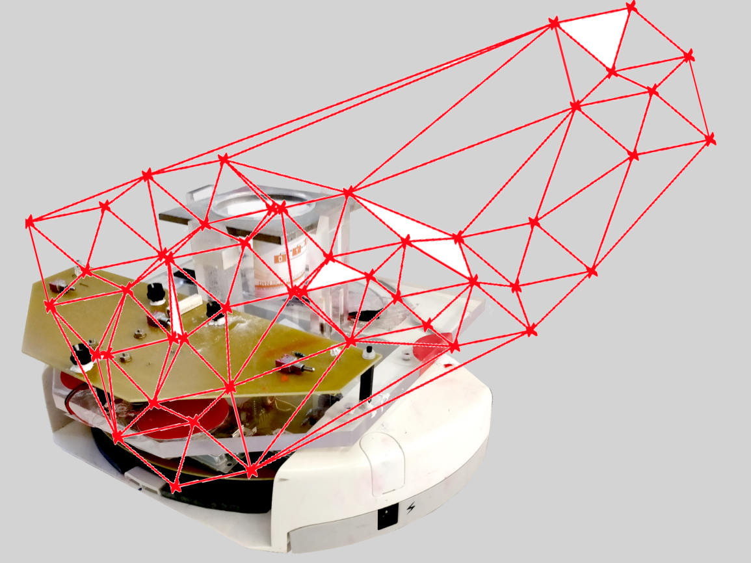
Project group SS18
Development of local positioning system for a pipe-less plant

Slide 2
Task since last meeting
Current Plant Status
Ultra-sonic Sensor
Mobile Robots projects
Interface between C# and ROS
Starting Position and Orientation
RFID: Check the following (weak) points
Accuracy
Data rate
Real applications/projects
Bottlenecks
Orientation
Prices

Slide 3
1. Current Plant Status
Arslan
Final Feb. 2015
Remote Control of the AGVs works
Camera Calibration
Didn´t find chessboard in image no. 1 or no. 2
Livestream
Camera Calibration
Live Video
AGVs start driving automatically

Slide 4

Fixing the Chessboard Pattern
-Result: Camera can still not detect the Pattern

Slide 5
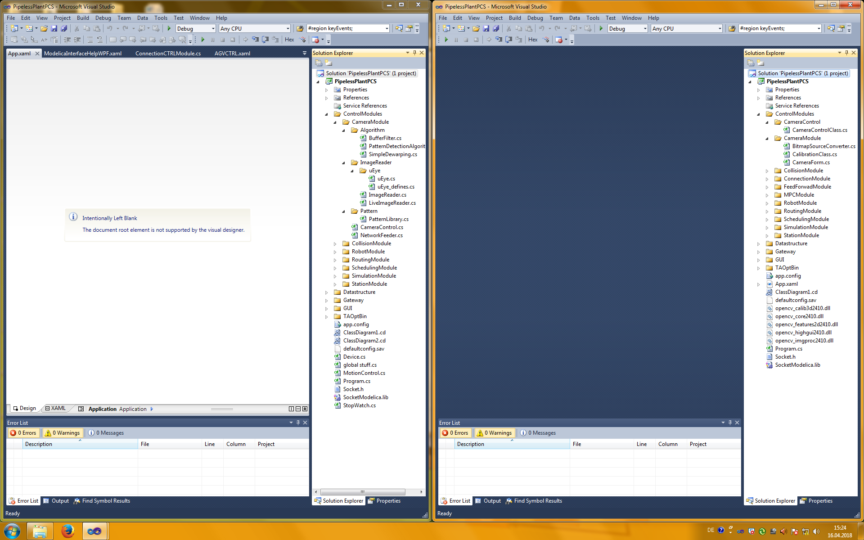
Combination of working Software
Result: Working CameraModule was not compatible with the Arslan Software.

Slide 6
Automatically driving AGVs
Comaration failure code with woring code
Modifing all lines which set velocity
Copy of the working Robot Module to the failure Software
Result: Robots are still driving directly after Putty configuration

Slide 7
2. Ultrasonic Sensor
No multi-robots projects
They might well conflict if they are near
Delay between transmitting each ultrasonic sensor to be different from the other robots transmitting and receiving (suggested by users)
Slightly different angles from one another (suggested by users)

Slide 8
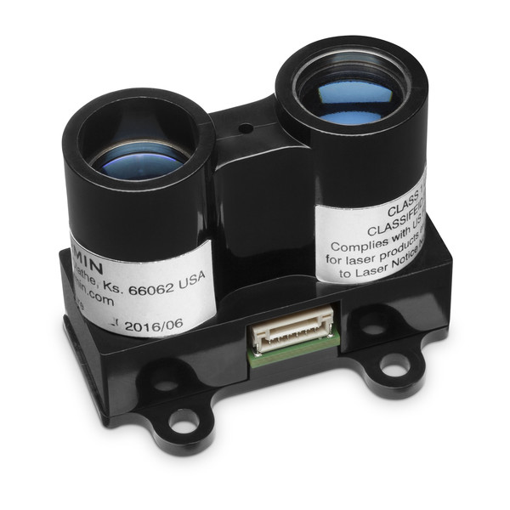
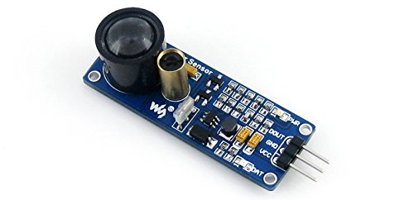
Alternatives
 | Waveshare Laser | LIDAR-Lite v3 (Garmin)
Picture
Range | 1.5 m | 40 m
Resolution | 1 cm | 1 cm
Frequency | 180 KHz | 650 KHz 1000 KHz (short distance)
Applications | Not yet | Quadcopter, etc.
Price | 14 € | 130 €

Slide 9
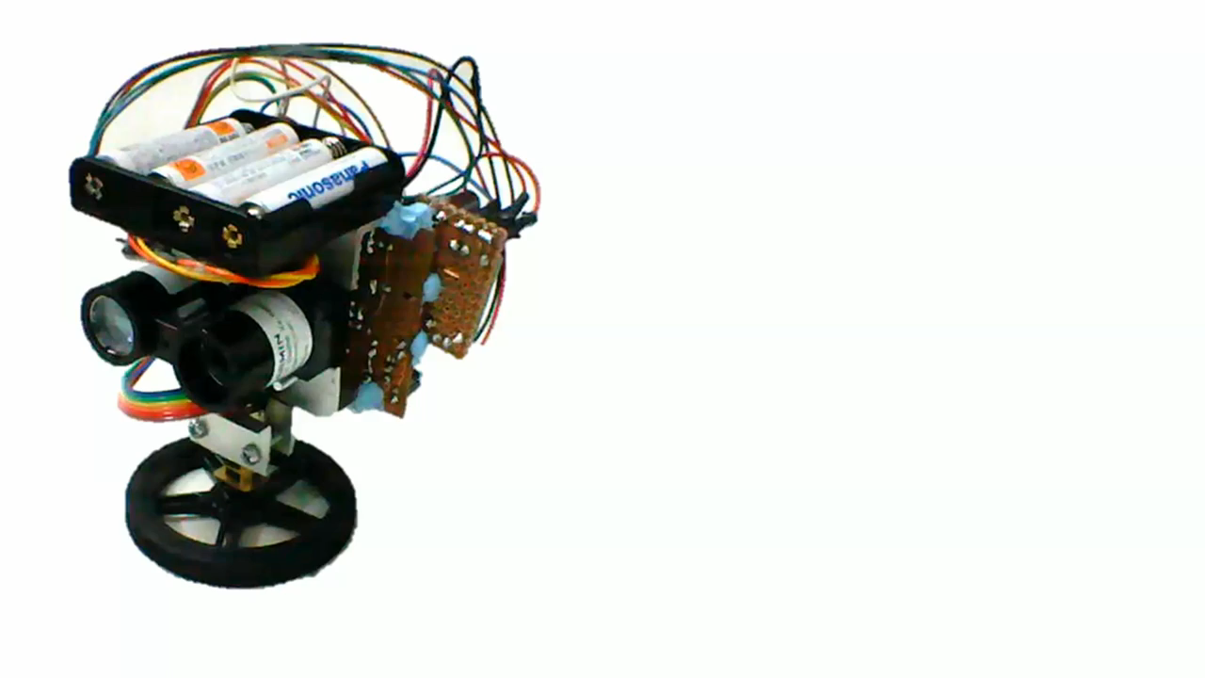
LIDAR-Lite v3 (Garmin)

Slide 10
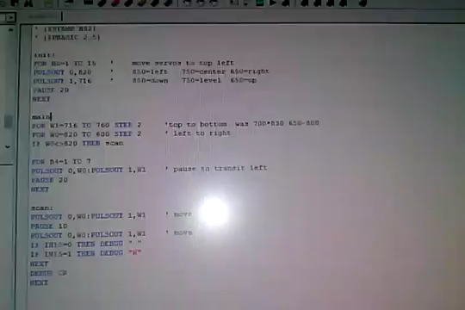
Waveshare Laser

Slide 11
Starting Position and Orientation
Starting and Ending of each robot task at known Position and Orientation (Docks)
Random movement for each robot to localize it self between the surrounding known obstacles & Estimating the initial position
Adding unique obstacles in the plant for the robot not getting lost

Slide 12
Worst Case Scenaio
Getting Lost
Similar Landmarks (using Ultrasonic Sensor)
Should surround the plant with walls

Slide 13
Interface between C# and ROS
ROS on Windows Installation
If you are running Windows 10 (version 1703) or newer it is possible to install and use ROS through the Windows Subsystem for Linux (WSL).
ROS VSCode Extension
This Visual Studio Code(VSCode) extension provides support for Robot Operating System (ROS) development.

Slide 14
Communication
ROSCS
roscs integrates C# written programs into ROS. It only provides support for mono under linux. A Windows extension is not planned.
XMLRPC
Using XMLRPC to communicate between C++/Python ROS nodes on the Unix machine and the C# application on Windows

Slide 15
Communication
YARP
Not simple but efficient.
Avoids bridges
C# support provided is non-native, via SWIG(Simplified Wrapper and Interface Generator)

Slide 16
Communication
ICE
works on a very broad range of operating systems (windows, linux, osx etc.) and languages (c++, c#, java etc.)
shares with ROS the feature, that it is very easy to use and very quickly to setup(for simpler tasks)
Compared to ACE, OpenRTM and Yarp, ICE is definitely the easiest and performance-wise strongest choice.
Simple

Slide 17
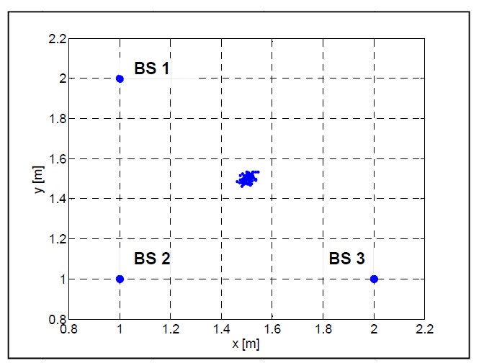
3. RIFD: Accuracy
Approach with SAW (surface acoustic wave) Compressive Receivers (ToA and PoA)
For an SNR (signal-to-noise-ratio) above 10 dB
MPE below 1.5%

Slide 18
Accuracy
Active ultra-wideband (UWB) systems can tell you the location of a tagged asset to within a few centimeters. (RFID journal, http://www.rfidjournal.com/blogs/experts/entry?11454)

Slide 19
Data rate and others
Complicated.
Information differ from 90 ms (project FH Dortmund) to a couple of seconds
No problem with the reading of multiple tags at once. Most readers have an anti-collision

Slide 20

Real Project System 1

Slide 21
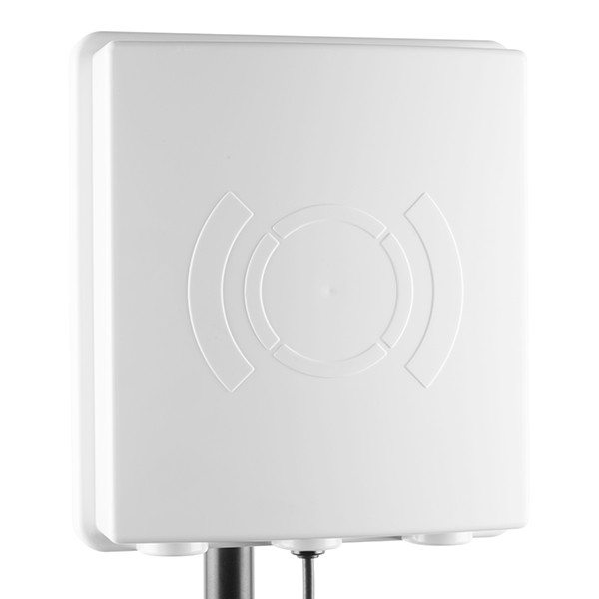
Real Project System 1
UHF RFID ANTENNA
860-960 MHz
4.5m range

Slide 22
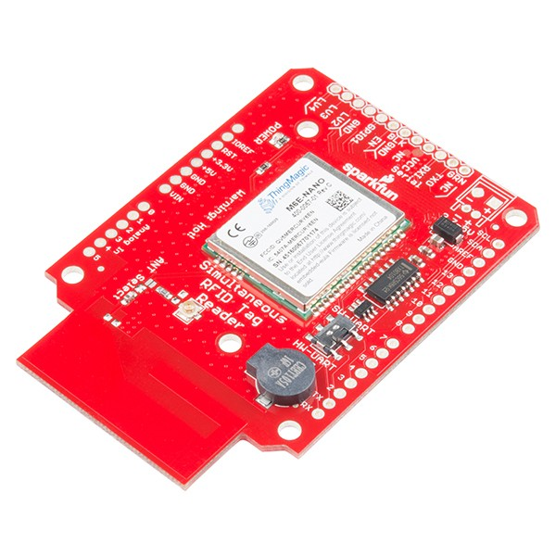
Real Project System 1
SIMULTANEOUS UHF RFID READER
Simultaneous Tag reading
150 Tags per second
Connection via. USB
Aduino compatible
Signal strength available

Slide 23
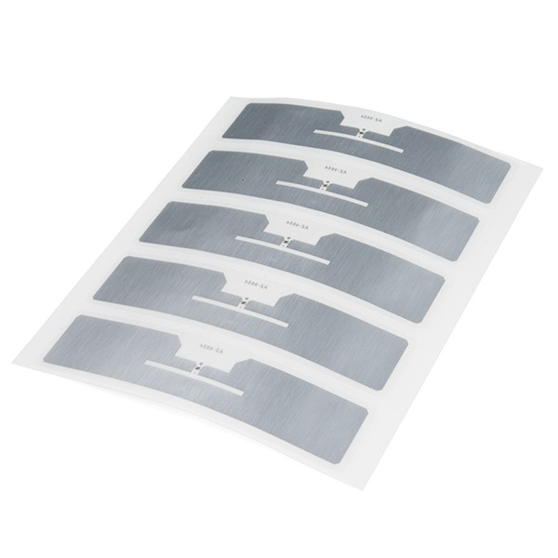
Real Project System 1
UHF RFID TAG - ADHESIVE
Can be sticked to any material
Read and Write
Truly unique ID (TID)

Slide 24


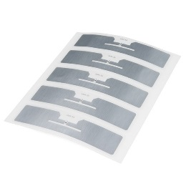
Real Project System 1
UHF RFID ANTENNA
3 x 34,95 € = 104,85€
RFID READER
3 x 199,95 € = 599,85€
UHF RFID TAG
1 x 1,50 € = 1,50€
706,20€

Slide 25
Bottleneck
3 Reader 1 Tag
Antenna can read 150 Tags per second.
Estimated bottleneck will be the Computation of the data send via USB

Slide 26
Real project system 2
FH Dortmund RFID-Based Localization of Mobile Robots Using the Received Signal Strength Indicator of Detected Tags
Passive tags on the floor, one reader on the robot
Adv: Accuracy is better (detection area is smaller)
+ no reflection problems in a smaller detection area)
Combine with geometry
RMSE around 30 mm
Drawback:
Data on the robot.
Has to send to the PC

Slide 27
Real project system 2
One Reader per Robot = 4 x 150€ = 600€
9 Tags per m² = 9 x 10m² x 0,2€ = 18€
Total price: 618€

Slide 28
Bottleneck
1 Reader many Tags
Computation on Aduino

Slide 29
Orientation
Initial Turn of 90° clowise

Slide 30
Orientation

Slide 31
ZiggBee & RFID
ZiggBee: 2,40GHz – 2,48GHz
RFID: 860 MHz – 960 MHz
Conclusion: ZiggBee and RFID Frequenzies don´t disturbe each other.

Slide 32
Worst Case Scenaio
Reflection of RFID signal at Metallic objects
High noise at the Metallic Stations
Wrong location near Metall

Slide 33
Which Localization Method

